Slide 1
Device Drivers
Witawas Srisa-an
Embedded Systems Design and Implementation

Slide 2
Device Drivers
What are device drivers?
  What are they used for?
  Why are they important?
Abstraction of underlying hardware from the OS and
applications.
Provide uniform APIs to access hardware.

Slide 3
Introduction
Device drivers
  Black boxes to hide details of hardware devices
  Use standardized calls
    Independent of the specific driver
  Main role
    Map standard calls to device-specific operations
  Can be developed separately from the rest of the kernel
    Plugged in at runtime when needed

Slide 4
The Role of the Device Driver
Implements the mechanisms to access the hardware
  E.g., show a disk as an array of data blocks
Does not force particular policies on the user
  Examples
    Who many access the drive
    Whether the drive is accessed via a file system
    Whether users may mount file systems on the drive

Slide 5
Introduction
A device driver is computer program that allows a system to interface with hardware devices.
Example driver: printer driver, bluetooth driver
Example devices: your USB stick, sensors: accelerometer
It is a translator between the operating system and applications the use the devices and the devices.
A typical operating system has many device drivers built into it.
A device driver converts general IO instructions into device specific operations.
Device drivers operate in a privileged mode→ requires careful design
6/13/2013

Slide 6
Why Device Driver?
A typical computing system (lap top, computer, cell phone, PDA, Point of sale system) deals with a variety of devices.
Making a hardware device work as expected is a cumbersome task.
Instead adding this code every application, operating system provides a single point interface for all devices by hosting the device drivers.
Adding it under the operating systems provides the protection and security needed for the device drivers from malicious use.
The device drivers are essentially shared dynamically linked libraries.
6/13/2013

Slide 7
Policy-Free Drivers
A common practice
  Support for synchronous/asynchronous operation
  Be opened multiple times
  Exploit the full capabilities of the hardware
Easier user model
Easier to write and maintain
To assist users with policies, release device drivers with user programs

Slide 8
Why Do We Need Drivers?
Custom platforms
  Contain many peripheral devices and kernel (e.g. CE) supported CPU
    OAL development to get kernel to boot on the board
    Device drivers to allow applications to access peripheral devices

Slide 9
An Example
To access a serial port in Windows CE
  calls CreateFile( ) on COMx
  calls WriteFile( ) to write some bytes of data to the serial port
  calls CloseHandle( ) to close the serial port.

Slide 10
Drivers in CE
A driver is simply a dynamic-link library (DLL)
  DLLs are loaded into a parent process address space
  Run in user mode (different than most OSs)
  the parent process can then call any of the interfaces exposed from the DLL
    LoadLibrary( )
    LoadDriver( ) --- memory resident

Slide 11
Writing Device Drivers
Most of the time spent on system integration is in this process
  Some devices have support on standard CE release and some don’t
    Onboard or installable
      Onboard devices may require platform dependent modification to the kernel image
      Installable devices may require code to be more platform independent
  Drivers APIs can also be used to provide application-level services

Slide 12
Device Driver Models
Device drivers, over the years, have become very complex
  Drivers are separated into classes
    Serial, network, audio, video, touch panel, etc.
  Layer approach is used
    To support a new device, a layer is modified instead of rewriting the entire driver
    Processing functions required for a given class often do not require modification

Slide 13
File abstraCtion
What do you with a device? {read, write}, {read only}, {write only}
Lets look at some examples: USB device, CD-ROM, LED Display,
What do you do with a file? open, close, read, write, ..
File is an excellent abstraction for devices.
6/13/2013

Slide 14
/dev partial listing
total 380
lrwxrwxrwx 1 root 30 Mar 7 2004 allkmem -> ../devices/pseudo/mm@0:
allkmem
lrwxrwxrwx 1 root 27 Aug 15 2001 arp -> ../devices/pseudo/arp@0:arp
lrwxrwxrwx 1 root 7 Aug 15 2001 audio -> sound/0
lrwxrwxrwx 1 root 10 Aug 15 2001 audioctl -> sound/0ctl
lrwxrwxrwx 1 root 11 Oct 4 03:06 bd.off -> /dev/term/b
drwxr-xr-x 2 root 512 Aug 17 2001 cfg
lrwxrwxrwx 1 root 31 Aug 15 2001 conslog -> ../devices/pseudo/log@0
:conslog
lrwxrwxrwx 1 root 30 Aug 15 2001 console -> ../devices/pseudo/cn@0:
console
drwxr-xr-x 2 root 512 Aug 15 2001 cua
drwxr-xr-x 2 root 2048 Aug 31 2002 dsk
lrwxrwxrwx 1 root 29 Aug 15 2001 dump -> ../devices/pseudo/dump@0:d
ump
lrwxrwxrwx 1 root 50 Aug 15 2001 ecpp0 -> ../devices/pci@1f,4000/eb
us@1/ecpp@14,3043bc:ecpp0
lrwxrwxrwx 1 root 8 Aug 15 2001 fb0 -> fbs/ffb0
drwxr-xr-x 2 root 512 Aug 15 2001 fbs
dr-xr-xr-x 2 root 528 Nov 9 11:51 fd
lrwxrwxrwx 1 root 30 Apr 7 2002 fssnapctl -> ../devices/pseudo/
6/13/2013

Slide 15
Device SPACE
Typically there are multiple devices of the same type.
All the devices controlled by the same device driver is given the same “major number”
A “minor number” distinguishes among the devices of the same type.
Example: printers have a major number since purpose is same, minor# is denote a specific printer
6/13/2013

Slide 16
Splitting the Kernel
Process management
  Creates, destroys processes
  Supports communication among processes
    Signals, pipes, etc.
  Schedules how processes share the CPU
Memory management
  Virtual addressing

Slide 17
Splitting the Kernel
File systems
  Everything in UNIX can be treated as a file
  Linux supports multiple file systems
Device control
  Every system operation maps to a physical device
    Few exceptions: CPU, memory, etc.
Networking
  Handles packets
  Handles routing and network address resolution issues

Slide 18
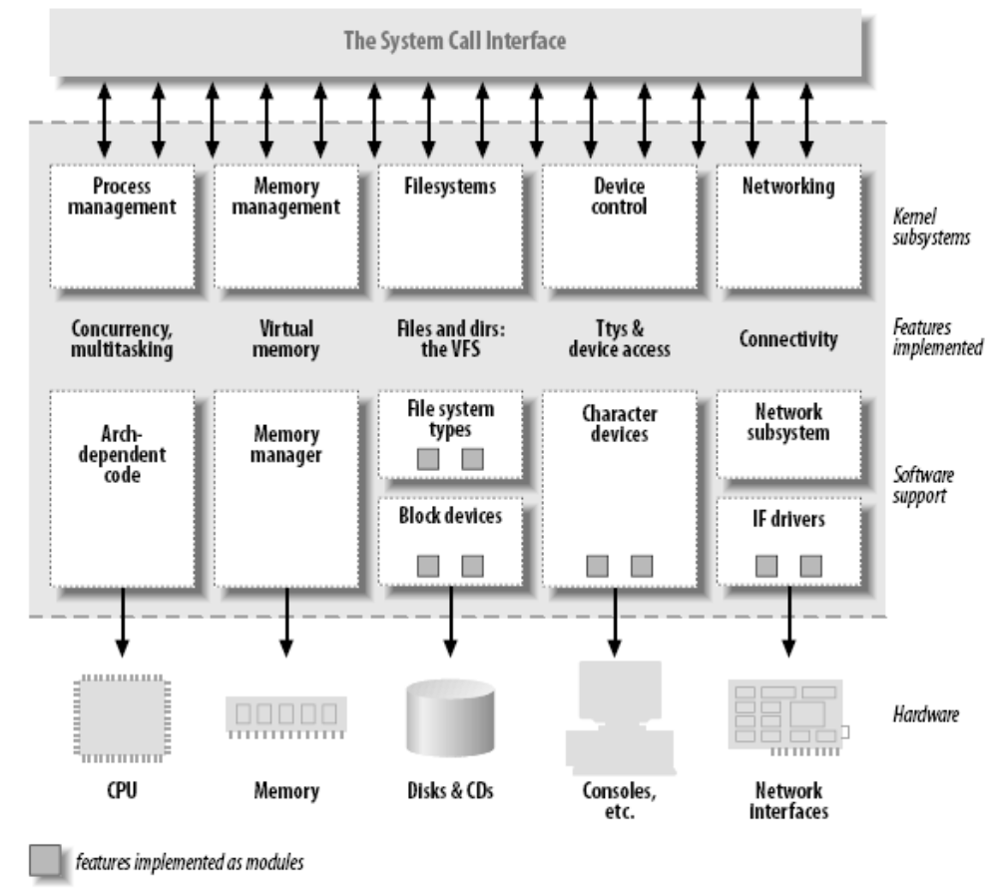
Splitting the Kernel

Slide 19
Loadable Modules
The ability to add and remove kernel features at runtime
Each unit of extension is called a module
Use insmod program to add a kernel module
Use rmmod program to remove a kernel module

Slide 20
Device Driver Architecture
Device Drivers
Interrupt Service Threads
User Mode
Kernel Mode
Interrrupt Service Routines
Kernel
OAL
From Wilson and Havawala, Building Powerful Platform with Windows CE
Addison-Wesley, 2001 page 227.

Slide 21
Stream-Interface
Allow accesses to an array of devices through basic file I/O interfaces
  Often used for installable devices
  The device manager (DM) manages stream-interface drivers
    DM operates as its own process
      Device driver DLLs are mapped into the address space

Slide 22
Other Driver Models
Native Interface
USB Interface
Network Device Interface Specification

Slide 23
Classes of Devices and Modules
Character devices
Block devices
Network devices
Others

Slide 24
Character Devices
Abstraction: a stream of bytes
  Examples
    Text console (/dev/console)
    Serial ports (/dev/ttyS0)
  Usually supports open, close, read, write
  Accessed sequentially (in most cases)
  Might not support file seeks
  Exception: frame grabbers
    Can access acquired image using mmap or lseek

Slide 25
Block Devices
Abstraction: array of storage blocks
However, applications can access a block device in bytes
  Block and char devices differ only at the kernel level
  A block device can host a file system

Slide 26
Network Devices
Abstraction: data packets
Send and receive packets
  Do not know about individual connections
Have unique names (e.g., eth0)
  Not in the file system
  Support protocols and streams related to packet transmission (i.e., no read and write)

Slide 27
Other Classes of Devices
Examples that do not fit to previous categories:
  USB
  SCSI
  FireWire
  MTD

Slide 28
File System Modules
Software drivers, not device drivers
Serve as a layer between user API and block devices
Intended to be device-independent

Slide 29
Security Issues
Deliberate vs. incidental damage
Kernel modules present possibilities for both
System does only rudimentary checks at module load time
Relies on limiting privilege to load modules
  And trusts the driver writers
Driver writer must be on guard for security problems

Slide 30
Security Issues
Do not define security policies
  Provide mechanisms to enforce policies
Be aware of operations that affect global resources
  Setting up an interrupt line
    Could damage hardware
  Setting up a default block size
    Could affect other users

Slide 31
Security Issues
Beware of bugs
  Buffer overrun
    Overwriting unrelated data
  Treat input/parameters with utmost suspicion
  Uninitialized memory
    Kernel memory should be zeroed before being made available to a user
    Otherwise, information leakage could result
      Passwords

Slide 32
Security Issues
Avoid running kernels compiled by an untrusted friend
  Modified kernel could allow anyone to load a module

Slide 33
Version Numbering
Every software package used in Linux has a release number
  You need a particular version of one package to run a particular version of another package
  Prepackaged distribution contains matching versions of various packages

Slide 34
Version Numbering
Different throughout the years
After version 1.0 but before 3.0
  <major>.<minor>.<release>.<bugfix>
  Time based releases (after two to three months)
3.x
  Moved to 3.0 to commemorate 20th anniversary of Linux
  <version>.<release>.<bugfix>
  https://lkml.org/lkml/2011/5/29/204

Slide 35
License Terms
GNU General Public License (GPL2)
  GPL allows anybody to redistribute and sell a product covered by GPL
    As long as the recipient has access to the source
    And is able to exercise the same rights
  Any software product derived from a product covered by the GPL be released under GPL

Slide 36
License Terms
If you want your code to go into the mainline kernel
  Must use a GPL-compatible license

Slide 37
Joining the Kernel Development Community
The central gathering point
  Linux-kernel mailing list
  http://www.tux.org/lkml
Chapter 20 of LKM further discusses the community and accepted coding style

Slide 38
Device Driver Labs
http://www.microsoft.com/downloads/details.aspx?FamilyID=486E8250-D311-4F67-9FB3-23E8B8944F3E&displaylang=en
Download lab tools from the course website
Create a simple Internet Appliance Windows CE project
Create a device driver workspace and build the workspace
Build OS image
Attach the device
Open prompt through build OS | Open Release Directory
  dumpbin –exports StreamDrv.dll

Slide 39
XINU
Xinu Is Not Unix, is an operating system for embedded systems, originally developed by Douglas Comer for educational use at Purdue University in the 1980s. The name is both recursive, and is Unix spelled backwards.
https://xinu.cs.purdue.edu/
https://en.wikipedia.org/wiki/Xinu
https://github.com/xinu-os/xinu

Slide 40
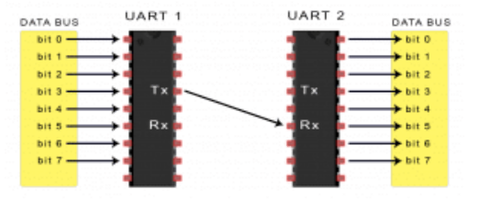
UART
UART stands for Universal Asynchronous Receiver/Transmitter.
It's not a communication protocol like SPI and I2C, but a physical circuit in a microcontroller, or a stand-alone IC.
A UART's main purpose is to transmit and receive serial data.

Slide 41
Examples from XINU
Take a look at files in the include directory:
device.h
tty.h
uart.h
Also in the system directory devtable.c, initialize.c
Bottom line is this, for a device xyz:
1. Include a file in include directory: xyz.h
  -- define the operations/functions for the device
2. Add a directory xyz
-- implement all functions each in its own file
3. Add an entry in the devtable.c for the device (note that this has the “minor” device number along with other things)
6/13/2013

Slide 42
Lets Analyze the XINU UART Driver
Starting point: uart.h in include directory
uart directory functions
system directory devtable.c, initialize.c
Usage of the devices is through device table:
Ex:
pdev = &devtab[i];
(pdev→init)(pdev);
6/13/2013

Slide 43
UART Driver in EXINU
General device driver related files: device.h, devtable.c
Uart files: uart.h defining the physical features of the uart
All the files in the uart directory that implement the operations related to the uart.
  uartControl.c uartInit.c uartIntr.c
  uartPutChar.c uartWrite.c uartGetChar.c uartRead.c
6/13/2013

Slide 44
Device Drivers
On board devices are called internal peripherals and one outside are called external peripherals
  UART Chip (internal)
  TTY (external)
UART→ transceiver→RS232→D-9 connector → laptop serial socket
  WRT54GL board and modifications
6/13/2013

Slide 45
Device drivers (contd.)
Embedded processor interacts with a peripheral device through a set of control and status registers.
Registers are part of the peripheral device.
Registers within a serial controller are different from those in a timer.
These devices are located in the memory space of the processor or I/O space of the processor-- two types: memory-mapped or I/O mapped respectively.
6/13/2013

Slide 46
Device driver (contd.)
The keyword volatile should be used when declaring pointers to device drivers.
  Bit patterns for testing, setting, clearing, toggling, shifting bits, bitmasks, and bitfields.
Struct overlays:
  In embedded systems featuring memory mapped IO devices, it is common to overlay a C struct on to each peripheral’s control and status registers.
  This will provide the offsets for the various registers from the base address of the device.
6/13/2013

Slide 47
Device Driver Philosophy
Hide the hardware completely: hardware abstraction
If the device generates any interrupts include interrupt controllers.
Device driver presents a generic interface for applications at higher level to access the devices: device.h
Device drivers in embedded systems are different from general purpose operating systems: See diagram in slide #14
  Applications in general purpose systems accesses OS (Operating Systems) which in turn accesses device drivers.
  Applications in embedded systems can directly access device drivers.
6/13/2013

Slide 48
General Purpose OS vs. Embedded System
Application
process
Application
process
Operating System: dev/xyz
Device driver
Device driver
Physical Device
hardware
Physical Device
hardware
6/13/2013

Slide 49
Device Driver development steps
An interface to the control and status registers.
Variables to track the current state of the physical and logical devices
  -- Major and minor device number, device name
A routine to initialize the hardware to known state
An API for users of the device driver
-- Read, write, seek
Interrupts service routines
6/13/2013

Slide 50
Example: A serial device driver
Read the text for explanation and general example of a timer
Now lets look at the UARTdriver of the embedded xinu and WRT54GL.
Study the tty driver that is a logical device that is layered on top of the UART driver.
Discuss how you would develop a device driver for a framebuffer.. This was a lab2 last year.
6/13/2013

Slide 51
Shift Operators
<< left shift
>> right shift
Usage:
unsigned int x = 70707;
//x = 00000000 00000001 00010100 00110011
unsigned int y, z;
y = x << 2;
// y = 00000000 00000100 01010000 11001100
z = x >> 2;
//z = 00000000 00000000 01000101 00001100
6/13/2013

Slide 52
Logic Operators
Bitwise & (AND)
Bitwise inclusive | (OR)
Bitwise exclusive ^ (XOR)
Bitwise negation ~
Usage:
unsigned exp1 = 1;
unsigned exp2 = 4;
printf (“ %d\n”, exp1 | exp2);
printf (“ %d\n”, exp1 & exp2);
printf (“ %d\n”, exp1 ^ exp2);
printf (“ %d\n”, ~exp1);
6/13/2013

Slide 53
Relevance of shift and logic operators
Bitwise operations are necessary for much low-level programming, such as writing to device drivers, low-level graphics, communications protocol packet assembly and decoding.
Device drivers use these operators to test the presence or absence of a bit in a serial port or a device input, for example. (checking for on or off)
6/13/2013

Slide 54
Summary
We studied the design and development of device drivers.
We analyzed the code for a sample UART driver.
6/13/2013

Slide 55
Linux Device Drivers & Project3 preview
CSC345

Slide 56
Project 3 Preview
Write a device driver for a pseudo stack device
Idea from http://www.cs.swarthmore.edu/~newhall/cs45/f01/proj5.html
Linux character device type supports the following operations
  Open: only one is allowed.
  Write: writes an char string to top of the device stack. Error if stack is empty
  Read: reads an item from top of the device stack. Error if stack is empty
  Release: release the device
Install with LKM.
Test: It will be a dedicated standalone machine in the lab. Root password may be given out. If you mess up, you will re-install the

Slide 57
What is a device driver?
A programming module with interfaces
  Communication Medium between application/user and hardware
In Unix,
  Kernel module
  device driver interface = file interface
  What are normal operations?
  Block vs. character

Slide 58
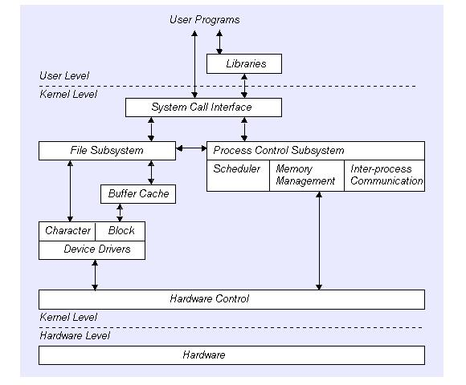
User program & Kernel interface
Note: This picture is excerpted from Write a Linux Hardware Device Driver, Andrew O’Shauqhnessy, Unix world

Slide 59
Loadable Kernel Module (LKM)
A new kernel module can be added on the fly (while OS is still running)
LKMs are often called “kernel modules”
They are not user program

Slide 60
Types of LKM
Device drivers
Filesystem driver (one for ext2, MSDOS FAT16, 32, NFS)
System calls
Network Drivers
TTY line disciplines. special terminal devices.
Executable interpreters.

Slide 61
Basic LKM (program)
Every LKM consist of two basic functions (minimum) :
  int init_module(void) /*used for all initialition stuff*/
  {
  ...
  }
  void cleanup_module(void) /*used for a clean shutdown*/
  {
  ...
  }
Loading a module - normally retricted to root - is managed by issuing the follwing command: # insmod module.o

Slide 62
LKM Utilities cmd
insmod
  Insert an LKM into the kernel.
rmmod
  Remove an LKM from the kernel.
depmod
  Determine interdependencies between LKMs.
kerneld
  Kerneld daemon program
ksyms
  Display symbols that are exported by the kernel for use by new LKMs.
lsmod
  List currently loaded LKMs.
modinfo
  Display contents of .modinfo section in an LKM object file.
modprobe
  Insert or remove an LKM or set of LKMs intelligently. For example, if you must load A before loading B, Modprobe will automatically load A when you tell it to load B.

Slide 63
Common LKM util cmd
Create a special device file
  % mknode /dev/driver c 40 0
Insert a new module
  % insmod modname
Remove a module
%rmmod modname
List module
  % lsmod
  Or % more /proc/modules
    audio 37840 0
    cmpci 24544 0
    soundcore 4208 4 [audio cmpci]
    nfsd 70464 8 (autoclean)

Slide 64
Linux Device Drivers
A set of API subroutines (typically system calls) interface to hardware
Hide implementation and hardware-specific details from a user program
Typically use a file interface metaphor
Device is a special file

Slide 65
Linux Device Drivers (continued)
Manage data flow between a user program and devices
A self-contained component (add/remove from kernel)
A user can access the device via file name in /dev , e.g. /dev/lp0

Slide 66
General implementation steps
Understand the device characteristic and supported commands.
Map device specific operations to unix file operation
Select the device name (user interface)
  Namespace (2-3 characters, /dev/lp0)
(optional) select a major number and minor (a device special file creation) for VFS interface
  Mapping the number to right device sub-routines
Implement file interface subroutines
Compile the device driver
Install the device driver module with loadable kernel module (LKM)
or Rebuild (compile) the kernel

Slide 67
Read/write (I/O)
Pooling (or synchronous)
Interrupt based

Slide 68
Device Driver interface
Note: This picture is excerpted from Write a Linux Hardware Device Driver, Andrew O’Shauqhnessy, Unix world

Slide 69
VSF & Major number
principal interface between a device driver and Linux kernel

Slide 70

File operation structure
struct file_operations Fops = {
  NULL, /* seek */
  xxx_read,
  xxx_write,
  NULL, /* readdir */
  NULL, /* select */
  NULL, /* ioctl */
  NULL, /* mmap */
  xxx_open,
  NULL, /* flush */
  xxx_release /* a.k.a. close */
};
struct file_operations Fops = {
  read: xxx_read,
  write: xxx_write,
  open: xxx_open,
  release: xxx_release, /* a.k.a. close */
  };
Watch out compatibility issue with Linux version

Slide 71
Device special file
Device number
  Major (used to VFS mapping to right functions)
  Minor (sub-devices)
mknod /dev/stk c 38 0
ls –l /dev/tty
  crw-rw-rw- 1 root root 5, 0 Apr 21 18:33 /dev/tty

Slide 72
Register and unregister device
  int init_module(void) /*used for all initialition stuff*/
  {
      /* Register the character device (atleast try) */
      Major = register_chrdev(0,
      DEVICE_NAME,
      &Fops);
      :
  }
  void cleanup_module(void) /*used for a clean shutdown*/
    {ret = unregister_chrdev(Major, DEVICE_NAME);
  ...
  }

Slide 73
Register and unregister device
compile
    -Wall -DMODULE -D__KERNEL__ -DLINUX –DDEBUG -I /usr/include/linux/version.h -I/lib/modules/`uname -r`/build/include
Install the module
    %insmod module.o
List the module
    %lsmod
If you let the system pick Major number, you can find the major number (for special creation) by
    % more /proc/devices
Make a special file
    % mknod /dev/device_name c major minor

Slide 74
Device Driver Types
A character device driver ( c )
  Most devices are this type (e.g.Modem, lp, USB
  No buffer.
A block device driver (b)
  through a system buffer that acts as a data cache.
  Hard drive controller and HDs

Slide 75
Implementation
Assuming that your device name is Xxx
Xxx_init() initialize the device when OS is booted
Xxx_open() open a device
Xxx_read() read from kernel memory
Xxx_write() write
Xxx_release() clean-up (close)
init_module()
cleanup_module()

Slide 76
kernel functions
add_timer()
  Causes a function to be executed when a given amount of time has passed
cli()
  Prevents interrupts from being acknowledged
end_request()
  Called when a request has been satisfied or aborted
free_irq()
  Frees an IRQ previously acquired with request_irq() or irqaction()
get_user*()
  Allows a driver to access data in user space, a memory area distinct from the kernel
inb(), inb_p()
  Reads a byte from a port. Here, inb() goes as fast as it can, while inb_p() pauses before returning.
irqaction()
  Registers an interrupt like a signal.
IS_*(inode)
  Tests if inode is on a file system mounted with the corresponding flag.
kfree*()
  Frees memory previously allocated with kmalloc()
kmalloc()
  Allocates a chu nk of memory no larger than 4096 bytes.
MAJOR()
  Reports the major device number for a device.
MINOR()
  Reports the minor device number for a device.

Slide 77
kernel functions
memcpy_*fs()
  Copies chunks of memory between user space and kernel space
outb(), outb_p()
  Writes a byte to a port. Here, outb() goes as fast as it can, while outb_p() pauses before returning.
printk()
  A version of printf() for the kernel.
put_user*()
  Allows a driver to write data in user space.
register_*dev()
  Registers a device with the kernel.
request_irq()
  Requests an IRQ from the kernel, and, if successful, installs an IRQ interrupt handler.
select_wait()
  Adds a process to the proper select_wait queue.
*sleep_on()
  Sleeps on an event, puts a wait_queue entry in the list so that the process can be awakened on that event.
sti()
  Allows interrupts to be acknowledged.
sys_get*()
  System calls used to get information regarding the process, user, or group.
wake_up*()
  Wakes up a process that has been put to sleep by the matching *sleep_on() function.

Slide 78
Pitfalls
Using standard libraries: can only use kernel functions, which are the functions you can see in /proc/ksyms.
Disabling interrupts You might need to do this for a short time and that is OK, but if you don't enable them afterwards, your system will be stuck
Changes from version to version

Slide 79
Resources
Linux Kernel API: http://kernelnewbies.org/documents/kdoc/kernel-api/linuxkernelapi.html
Kernel development tool http://www.jungo.com/products.html
Linux Device Drivers 2nd Edition by Rubini & Corbet, O'Reilly Pub, ISBN 0-596-00008-1

Slide 80
X Windows
Jyoti Gajrani jyotigajrani@gmail.com
Department of Computer Science & Engineering
GEC Ajmer
LINUX Shell Programming

Slide 81
Course topics
X Windows
x-window as client/ server system
Concept of window manager, remote computing & local displays,
xinitrc file,
Customize X work environment and applications
Customizing the fvwm window manager.

Slide 82
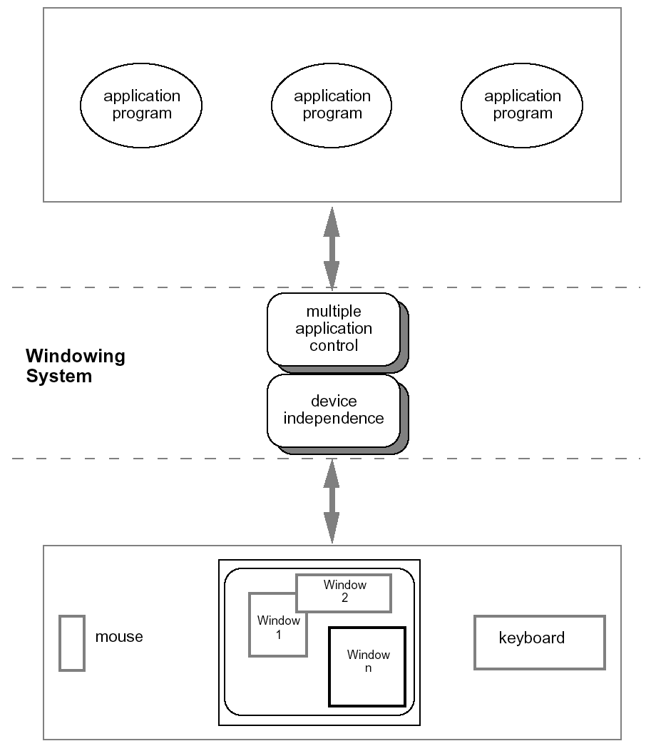
What is a windowing system ?
A windowing system is a system for sharing a computer's graphical display presentation resources among multiple applications at the same time.

Slide 83
Architectures of windowing systems
Three possible software architectures
  all assume device driver is separate
  differ in how multiple application management is implemented
1. each application manages all processes
  everyone worries about synchronization
  reduces portability of applications
2. management role within kernel of operating system
  applications tied to operating system
3. management role as separate application
maximum portability

Slide 84
X Windows
The X Windows System, also referred to as ‘X’ or “X11”, is the standard graphical engine for Unix and Linux. The X Window System is the basis for graphical user interfaces.
Linux also often confusingly is used to refer to systems like Debian, Ubuntu, Redhat, CentOs, Suse, and many more. These systems are better described as X11+Gnu+Linux.
It is largely OS and hardware independent, it is network-transparent, and it supports many different desktops.

Slide 85
X Windows cont’d
X was developed in the mid 80’s to provide a standard GUI for Unix systems, similar to Microsoft Windows.
Windows only runs locally on the machine, but X Windows uses the X Protocol to separate the processing and display for an application. It provides remote display feature.
Unlike Microsoft Windows, X is not part of the operating system. Although the X server used to have extraordinary privileges in order to utilize the graphics hardware

Slide 86
Features of X
Not part of OS
It has been said “MS-Windows is a windowing system with an OS stuck on as an after thought, and Unix/Linux is an OS with a windowing system stuck on as an after thought.”
Architecture Independent
Gnu (including Gnu+Linux), Bsd, Solaris, Hp-Ux, etc.
Network Transparent
Run application on a remote (possibly more powerful) machine, and display application locally. This is done on a per application, or per window basis, unlike VNC or remote desktop, that do it a desktop at a time.
Policy Free
X11 has no policy as to what things look like or how things are done. All the changes of look and feel are done by changing or replacing window managers and other helper apps.

Slide 87
Example
X model is really powerful; the classical example of this is running a processor-intensive application on a Cray computer, a database monitor on a Solaris server, an e-mail application on a small BSD mail server, and a visualization program on an SGI server, and then displaying all those on my Linux workstation's screen.

Slide 88
Does X-Window complete GUI?
X-Window is a piece of software that allows to draw windows on hardware displays. It only creates, moves and closes windows as well as interprets the mouse events like cursor moving and buttons click. X-Window does not provide all that necessary features like nice windows frames, color schemes, graphics effects, sounds etc.
- it is a job for Window Manager which works on the top of X-Window.

Slide 89
Window managers
The window manager is a special X client that controls the
placement and movement of applications,
provides title bars and control buttons etc.
Classic window managers include: kwm, twm, mwm, olwm, fvwm

Slide 90
Desktop Environment
(Some times merged with WM)
Yet another level running on top of window manager
Complete the desktop with:
  Icon based access to files and directories
  Overall system menus and toolbars
  Etc.
  GNOME, KDE are examples.

Slide 91
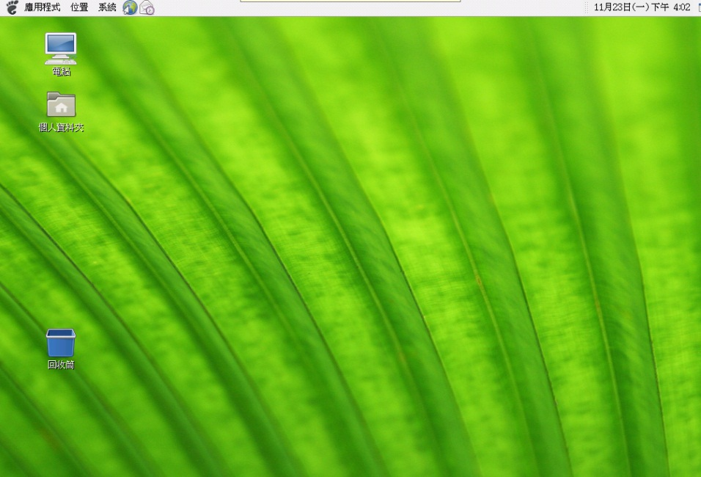
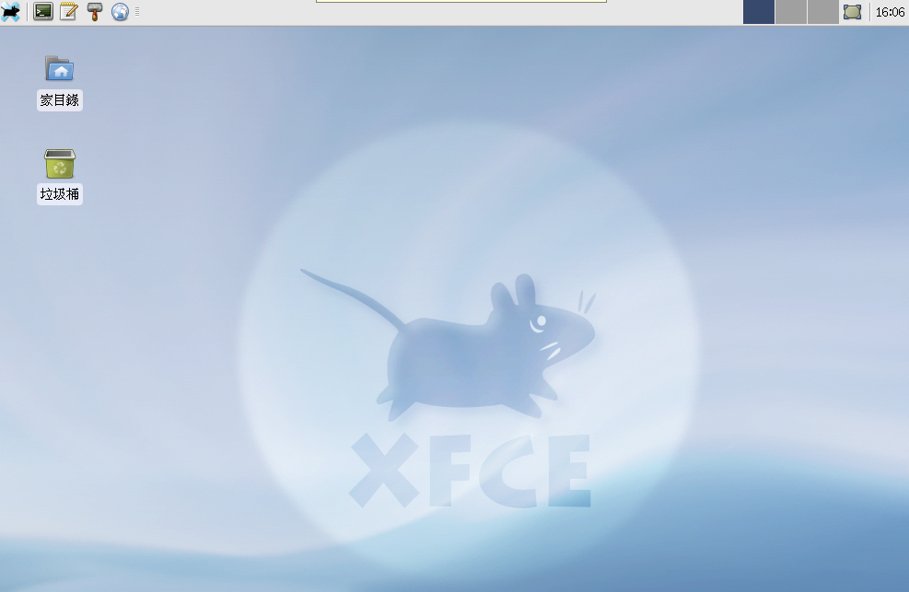
The Window Manager (2)
Some Popular Window Managers (+ DE)
  Gnome
  KDE
  Lxde
  Xfce
  Afterstep
  etc..

Slide 92
Linux GUI Components
Graphical Programs (X clients)
Desktop Environment
Window Manager
X Windows
Video Adapter Card Hardware

Slide 93
X Protocol
The X Protocol provides a client-server architecture at the application level:
The X client is the processing part of the application and may run on a remote machine.
The X server is the display and interaction system.

Slide 94
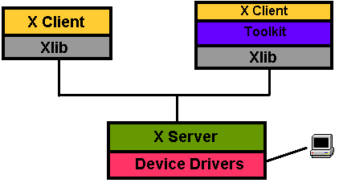
X Protocol cont’d
The X Protocol is also divided into device dependent and device independent layers.

Slide 95
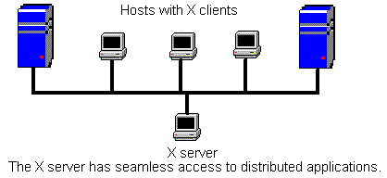
X architecture
The client-server nature of the X Protocol allows a single X server to support many clients (applications) on several hosts.

Slide 96
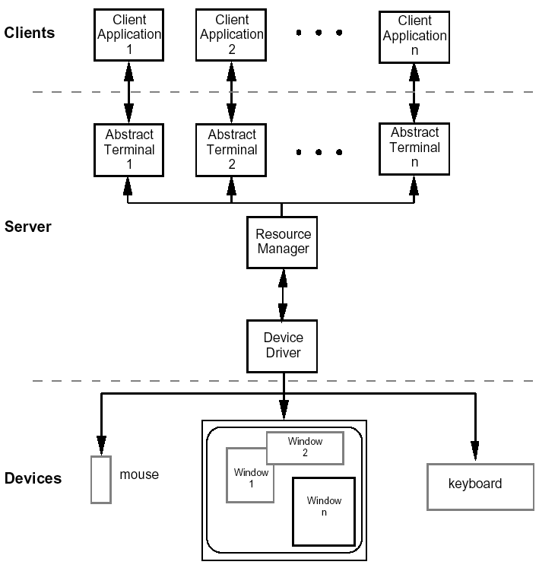
The client-server architecture

Slide 97
X Protocol messages
Requests – client sends requests to the server (e.g. create window)
Replies – server response to client requests
Events – server forwards events (such as mouse clicks or keyboard entry) to the client
Errors – server reports errors to the client

Slide 98
Using X Windows
First, an X server must be running:
On a local PC or workstation, you can usually start the X server with the “startx or xinit” command or it may start automatically, presenting a graphical login display.
Historical note: An X terminal is a dumb terminal that only runs the X server locally, and always connects to X clients on a remote host.

Slide 99
X Startup Commands
xinit - X Window System initializer
  xinit [ [ client ] options ] [ -- [ server ] [ display ] options ]
    Files
      Default client script:
        ~/.xinitrc
        /usr/local/lib/X11/xinit/xinitrc
      (run xterm if .xinitrc does not exist)
      Default server script:
        ~/ .xserverrc
        /usr/local/lib/X11/xinit/xserverrc
      (run X if .xserverrc does not exist)
startx:
  script to initiate an X session

Slide 100
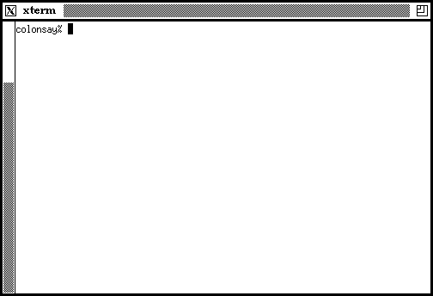
xterm
The most important X application is, rather ironically, the terminal program xterm.
Old school xterm:

Slide 101
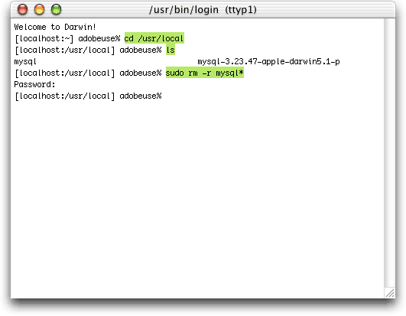
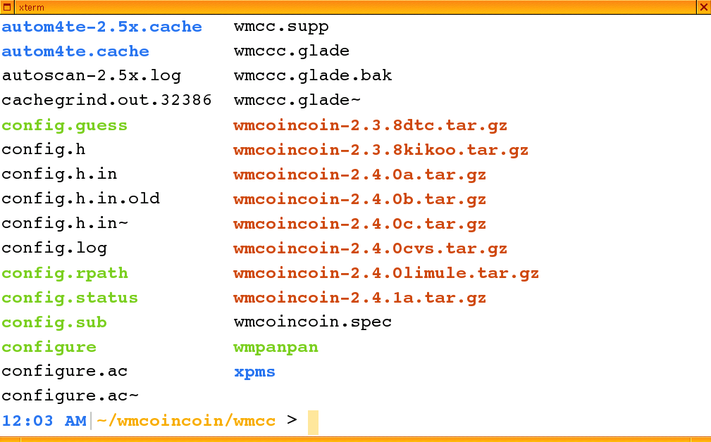
Xterm cont’d
OS X xterm:
Fancy xterm:

Slide 102

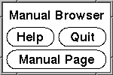
Some classic X apps
xman – manual pages app
Not this

Slide 103
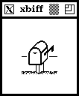
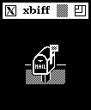
Some classic X apps
xbiff – mail notification
Back when we didn’t have mail servers (and we liked it!), mail was stored in local spool files and a process notified the user of new mail. xbiff is named after biff, which is named after Biff the dog, who barked at the postman. Seriously.

Slide 104
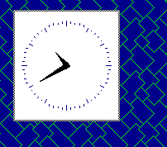
Some classic X apps
xclock – pretty self-explanatory

Slide 105
Starting X applications from remote Host
To launch an X client from a remote host for display on the local X server, you need to set two things:
1) Permission for the remote host to display X clients on the local machine.
xhost +remotehost
2) The target display for the remote application.
setenv DISPLAY=server:display

Slide 106
.xinitrc file
When startx or xinit is called, it search for .xinitrc file in home directory
The file can be modified to customize the X environment.
If not present then, default file which gets executed
- /etc/X11/xinit/xinitrc

Slide 107
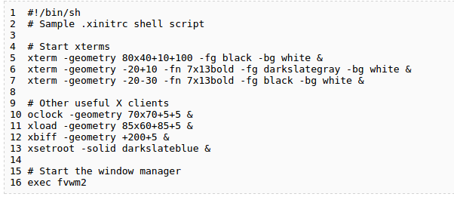
Customizing X Environment

Slide 108
Passing arguments to xinit
$ xinit gnome-session # start GNOME
$ xinit startkde # start KDE
$ xinit fvwm # start window manager fvwm
$ xinit xterm # start an xterm without a window manager
# Here Xfce is kept as default
session=${1:-xfce}
case $session in
awesome ) exec awesome;;
bspwm ) exec bspwm;;
catwm ) exec catwm;;
cinnamon ) exec cinnamon-session;;
dwm ) exec dwm;;
enlightenment ) exec enlightenment_start;;

Slide 109
ede ) exec startede;;
fluxbox ) exec startfluxbox;;
gnome ) exec gnome-session;;
gnome-classic ) exec gnome-session --session=gnome-classic;;
i3|i3wm ) exec i3;;
icewm ) exec icewm-session;;
jwm ) exec jwm;;
kde ) exec startkde;;
mate ) exec mate-session;;
monster|monsterwm ) exec monsterwm;;
notion ) exec notion;;
openbox ) exec openbox-session;;
unity ) exec unity;;
xfce|xfce4 ) exec startxfce4;;
xmonad ) exec xmonad;;
# No known session, try to run it as command
*) exec $1;;
esac

Slide 110
FVWM
F Virtual Windows Manager
While KDE and GNOME offer more features, they are also heavy on memory usage.
FVWM is light and fast, and you can customize it to meet your needs, and apply these customizations throughout your organization.
The default FVWM screen is very basic -- just a simple blue desktop.
Clicking anywhere with the left mouse button brings up a menu with a couple of built-in options, including xterm.

Slide 111
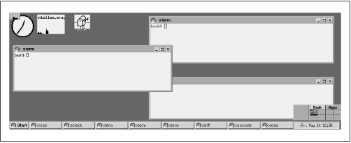
FVWM

Slide 112
FVWM FEATURES
Automatic desktop scrolling when the pointer reaches the screen boundary.
3D look and feel for window frames.
Fully configurable desktop menus, which appear when you press the mouse buttons.
A keyboard equivalent for almost every mouse-based feature; this is helpful when using X on laptops without a mouse or trackball

Slide 113
FVWM Configuration
FVWM uses the file ~/.fvwm/.fvwm2rc to override its default configuration.
Mouse 0 1 A Iconify
Mouse 0 2 A Maximize 100 100
Style "*" NoIcon //switch off the icons for minimised applications
EdgeResistance 1000 0 // 1 sec to switch between windows
maximize and minimize button for all windows

Slide 114
create a task bar at the bottom of the screen without functionality
Style "FvwmTaskBar" NoTitle, BorderWidth 0, HandleWidth 0, Sticky
AddToFunc InitFunction I Module FvwmTaskBar
AddToFunc RestartFunction I Module FvwmTaskBar

Slide 115
Adding functionality to taskbar
AddToMenu "Internet" "Internet" Title
+ "Firefox%mini-x.xpm%" Exec firefox &
+ "Thunderbird%mini-x.xpm%" Exec thunderbird &
AddToMenu "Main" "Main" Title
+ "xterm%mini-x.xpm%" Exec xterm &
+ "Internet%mini-x2.xpm%" Popup Internet
+ "Restart%mini-turn.xpm%" Restart
+ "Quit%mini-exclam.xpm%" Quit
*FvwmTaskBarStartMenu Main

Slide 116
Adding functionality dynamically to taskbar
AddToMenu ListFiles ListFiles Title
Piperead `for f in ~/*.html; do echo "+ $f Exec gedit $f"; done`

Slide 117

These bindings cause Ctrl-arrowkey to scroll the desktop by a full page in the given direction.

